Slide 1
Independent Reading
How do strong readers choose a book? What kind of selection strategies do they engage in?

Slide 2
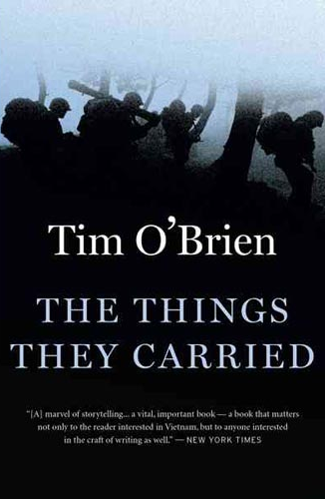
Summer Reading titles

Slide 3
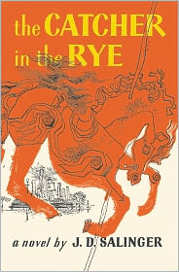
Classics

Slide 4
Contemporary

Slide 5
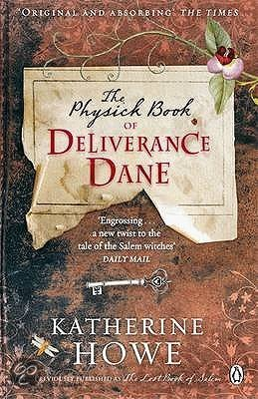
More Contemporary- Mystery/Suspense

Slide 6
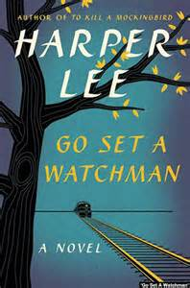
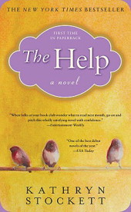
More Contemporary- a look at race issues

Slide 7
Nonfiction

Slide 8
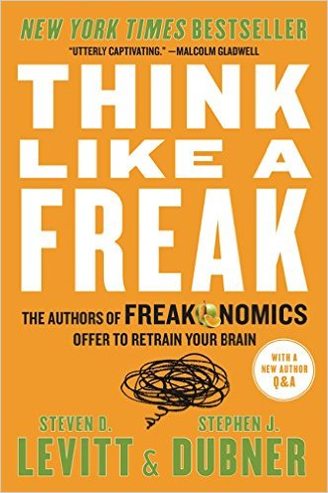
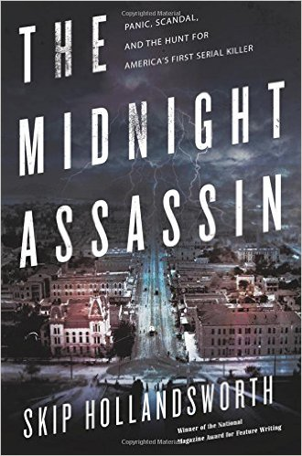
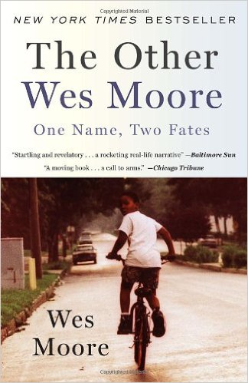
Nonfiction
Notes:
Hardest words: I don’t know; solving problems by going to the ROOT; interesting solutions: how the hot-dog champ developed strategy; incentives (m&ms), upside of quitting, persuading reluctant listeners

Slide 9
Nonfiction

